Slide 1

Methods of control

Slide 2
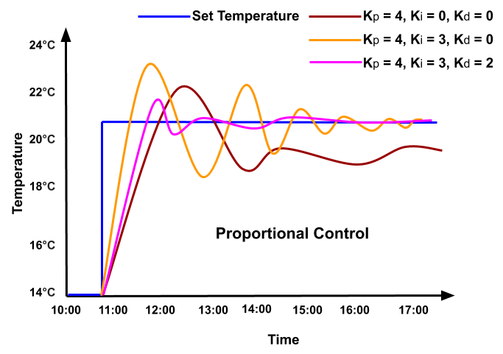
What is?
The PID controller is a black magic box that uses math and 3 constants to decrease the error of 2 numbers to zero. The error meaning the difference between the 2 numbers.
It uses 3 constants to achieve this, Kp, Ki, Kd. They change how the controller reacts and responds to change, from aggressivity, speed, acceleration, smoothness, etc.

Slide 3
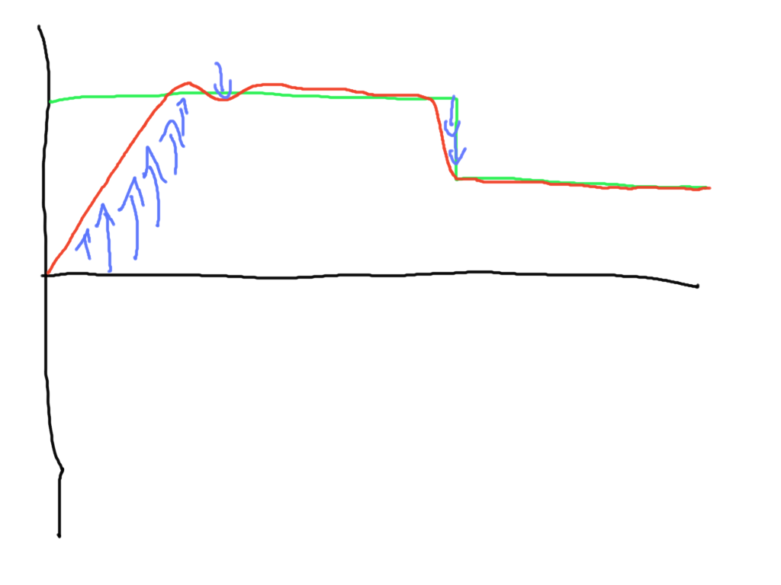
Kp
This is what drives the controller forward, this is the main driving factor that moves the numbers.
Being the main driving force means that if you have too much of it, it can lead to oscillations, too much P is the main reason for big oscillations.

Slide 4
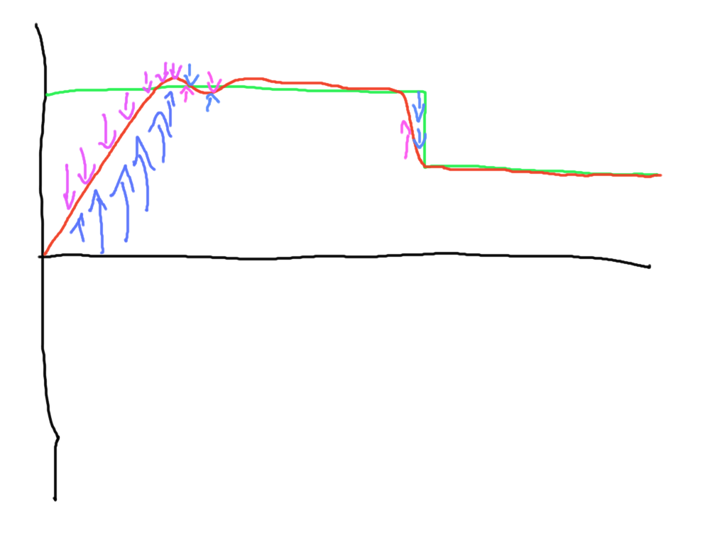
Kd
This fights the P’s drive if “fights” back and tries to smooth out the P.
If you have way to much D then you will see small but very aggressive oscillations, if you want your pid to be more aggressive but not overshoot, you can test some D out. Normally we start with a factor of 10 less than the P.

Slide 5
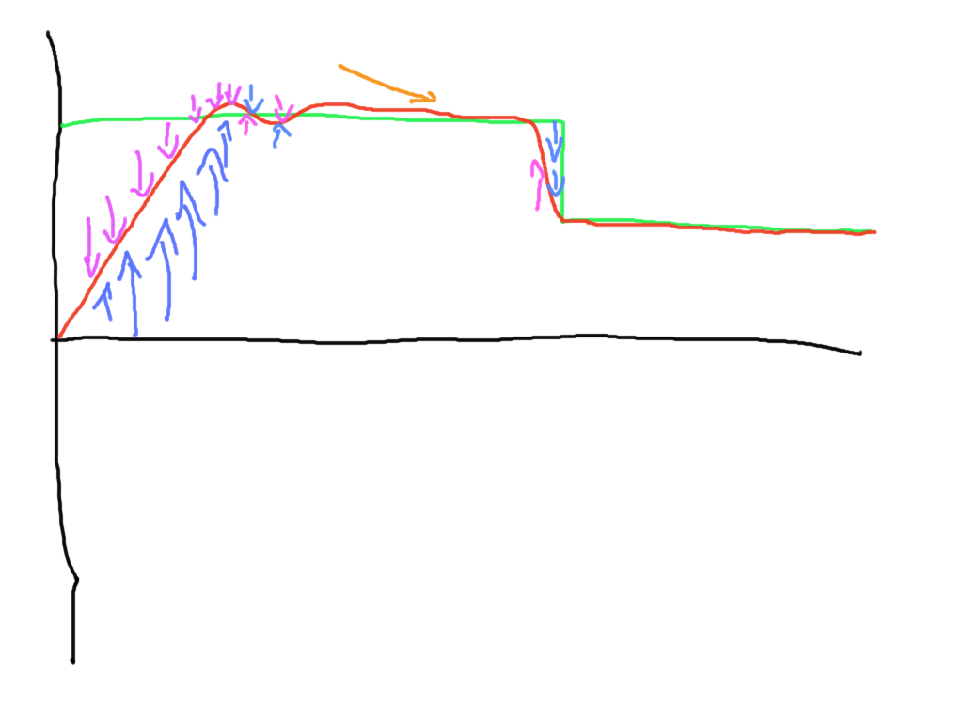
Ki
I this makes slow, over time changes, it makes sure that the value gets to the setpoint.
As you can see in the graph, the state is separated from the setpoint. But not by much, increasing the P here to make it more sensitive to smaller errors may cause it to overshoot, that's why I is used.

Slide 6
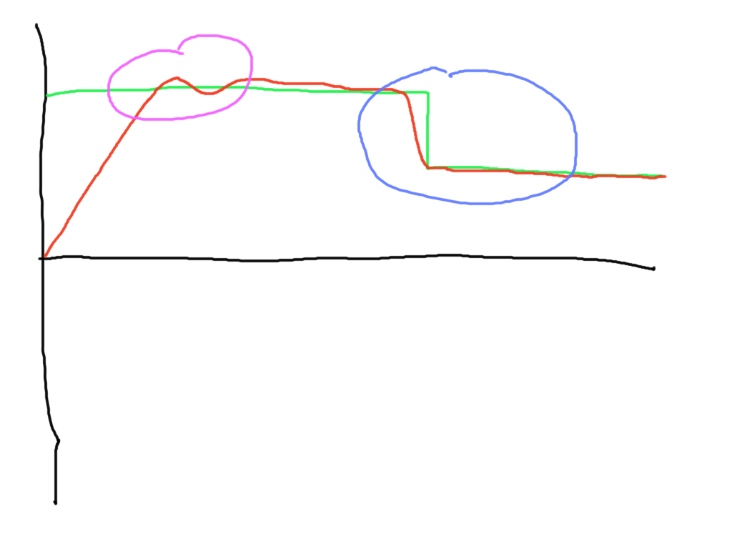
How well is it tuned?
In the pink area we can se oscillation and overshoot, this is bad because this could mean an arm driving against itself past its limits, or a ball overshooting from a shooter.
In the blue are there is no real visible overshoot and the response is pretty fast. That is well tuned.

Slide 7
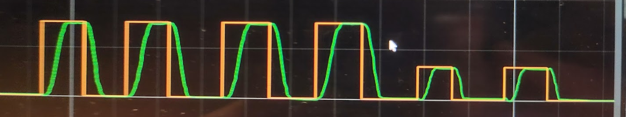
What do you think about this graph?

